Slide 1
Team Members:
Falgun Patel
Bei Ma
Yunwei Xu

Slide 2
Company History and Overview
PepsiCo was founded in 1965 via the merger of Pepsi-Cola and Frito-Lay. In 1966, Doritos brand tortilla chips were introduced.
Pepsi entered Japan and Eastern Europe and open a broad market.
In the 1970s Pepsi-Cola becomes the number one cola drink in the supermarkets.
PepsiCo became the second largest manufacturer of soft drink in the world; it has 22 different product lines that offer variety of high quality products providing refreshment and nutrition, like Quaker, Cheetos, Mirinda, Starbucks, Fritos, Aquafina, 7 up, Lay’s, Ruffles, which are all our favorites.

Slide 3
Corporate Mission
The mission of PepsiCo is to be the number one consumer products company worldwide mainly focusing on convenient foods and beverages.

Slide 4
Our Vision
“Our vision is put into action through programs and a focus on environmental stewardship, activities to benefit society, and a commitment to build shareholder value by making PepsiCo a truly sustainable company.”

Slide 5
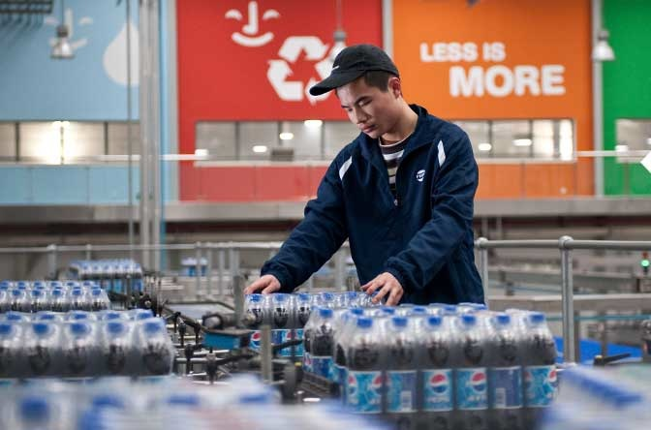
Values and Philosophy
Our Commitment: committed to delivering sustained growth through empowered people acting responsibly and building trust.
Sustained Growth: It is about the growth of people and company performance. It prioritizes both making a difference and getting things done.
Empowered people means we have the freedom to act and think in ways that we feel will get the job done
Responsibility and trust form the foundation for healthy growth.

Slide 6
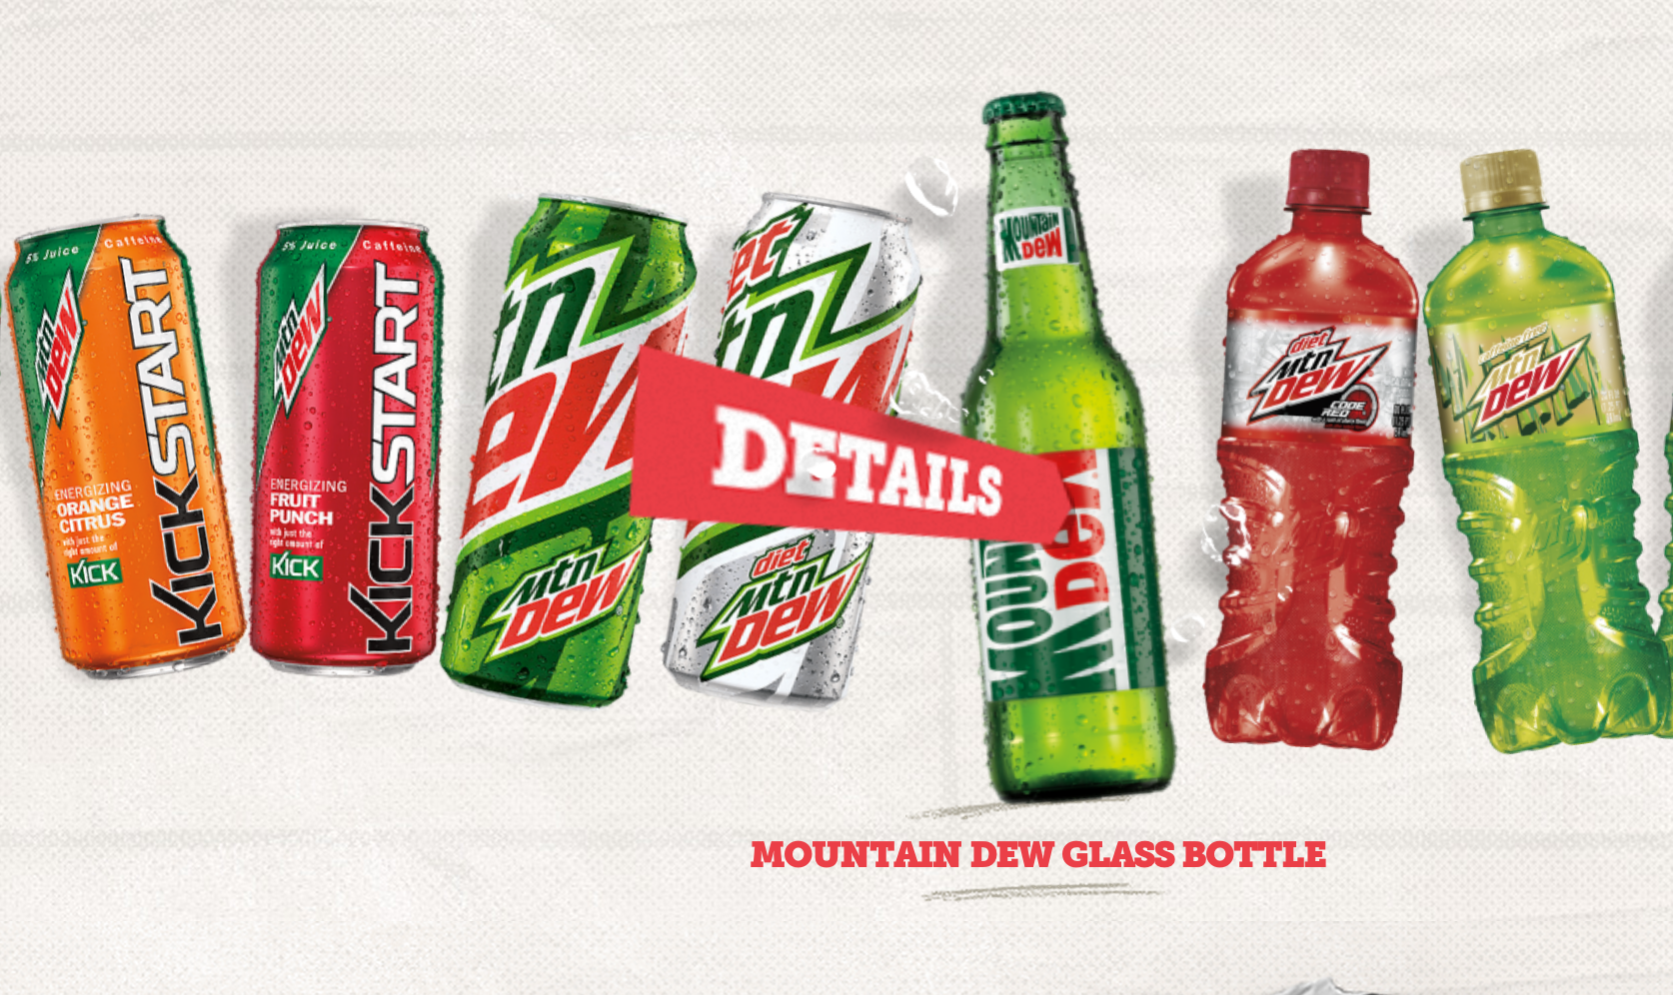
Strategies for Growth
PepsiCo has several key strategies for sustainable, long‐term growth, including:
Building a responsible and trustable company
Profitably growing the company’s beverage business worldwide
Seek to produce financial rewards to investors
Ensuring green environment, responsible financial management

Slide 7
Code for roadmap
Care for our customers and the world we live in.
Sell only products we can be proud of.
Speak with truth and candor.
Win with diversity and inclusion.
Respect others and succeed together.

Slide 8
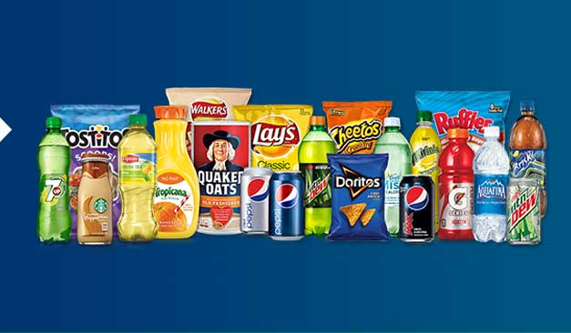
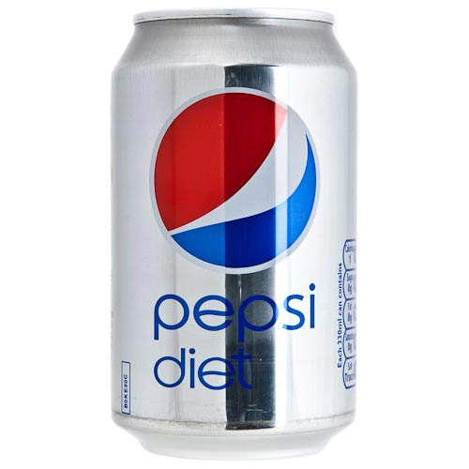
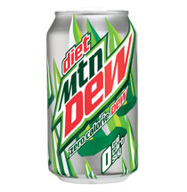
Products:
Product Scope:

Slide 9
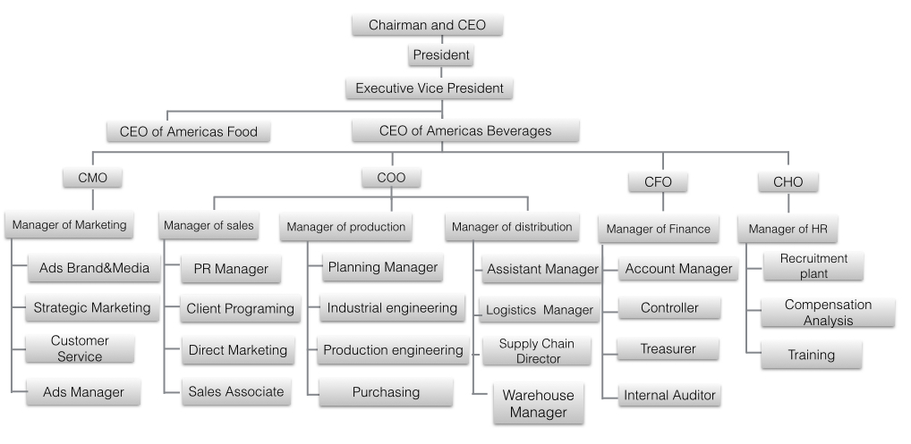
Organization Structure and Business Processes

Slide 10
Organization Structure and Business Processes
Headquarters | Plant | P___ | PepsiCo Inc. | Purchase, NY USA
Factory and Bottling Plant | Plant | P___ | The Pepsi Bottling Group, Inc. | Somers, NY USA
Factory and Bottling Plant | Storage Location Raw Materials | SL__ | The Pepsi Bottling Group, Inc. | Somers, NY USA
Bottling Plant | Storage Location Finished Goods | SL__ | The Pepsi Bottling Group, Inc. | Somers, NY USA
Distribution Center | Shipping Point | S___ | Refreshments Services Pepsi | Tallahassee, FL USA
Distribution Center | Storage Location Finished Goods | SL__ | Refreshments Services Pepsi | Tallahassee, FL USA

Slide 11
Bill of Materials
Material | Part number | Qty / Unit | Cost / Order | Order Qty | Cost / Unit | material type | Vendor
Water |  | 1 ltr | 400 | 4000 ltrs | 0.10 | raw | Crystal Clear Water Systems Mahopac, NY
Artificial Sweetener |  | 1 ltr | 280 | 140 ltrs | 2.00 | raw | American Sugar Refining Inc. Yonkers, NY
Diet Pepsi Flavoring Syrup |  | 1 ltr | 180 | 400 ltrs | 0.45 | raw | Pepsico
Diet Pepsi Cans |  | 7000 | 350 | 7000 | 0.05 | raw | Rexam Chicago, Illinois
Diet Pepsi Lids |  | 7000 | 70 | 7000 | 0.01 | raw | Rexam Chicago, Illinois
12 Pack Box for Diet Pepsi |  | 600 | 12 | 600 | 0.02 | raw | Nepa Carton and Carrier Co., Inc.
*Bill of materials for MTN Dew will be as similar as above

Slide 12
Work centers and Routing
Operation no.: | Ingredients / Parts used | Steps | Time (min) | Cost | Work Center | Plant
1 | water, artificial sweetener, flavouring syrup | mix the ingredients to form final product i.e. diet pepsi | 0.09 | 0.08 | WCPS | P110
2 | Diet Pepsi Can | fill the cans with diet pepsi | 0.02 | 0.01 | WCFL | P110
3 | Diet Pepsi Lid | seal the cans | 0.01 | 0.01 | WCSL | P110
4 | Diet Pepsi 12 Pack Carton | make 12 pack cases for distribution | 0.12 | 0.03 | WCPK | P110
*Routing and work centers for MTN Dew will be as similar as above

Slide 13
Vendor
Vendor Name | Location | Material Type | Material
American Sugar Refining Inc. | Yonkers, NY | Raw Material | Artificial Sweetener
Rexam Chicago, Illinois | Chicago, Illinois | Raw Material | Aluminum Cans
Crystal Clear Water Systems | Mahopac, NY | Raw Material | Water
Flexsystems USA, Inc. | El Cajon, CA | Trading Goods | Pepsi Key Chain
Nepa Carton and Carrier Co., Inc. | Moosic, PA | Raw Material | 12 Pack Cartons

Slide 14
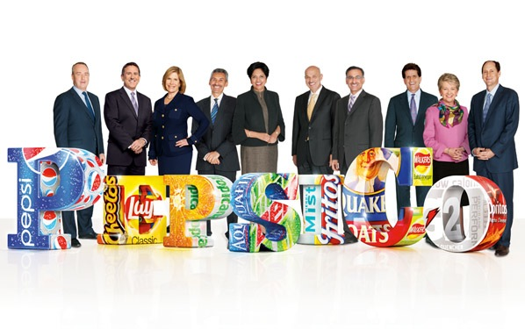
Major Customers
Customer Name |  | Location
Wal-Mart Stores, Inc. (Including Sam’s club) |  | 850 Cherry Avenue San Bruno, CA 94066
Fast Food Restaurant | KFC | 1900 Colonel Sanders Ln Louisville, KY 40213
 | McDonalds | McDonald's Corporation 2111 McDonald's Dr. Oak Brook, IL 60523
 | Burger King | Burger King Worldwide 5505 Blue Lagoon Drive Miami, FL 33126

Slide 15
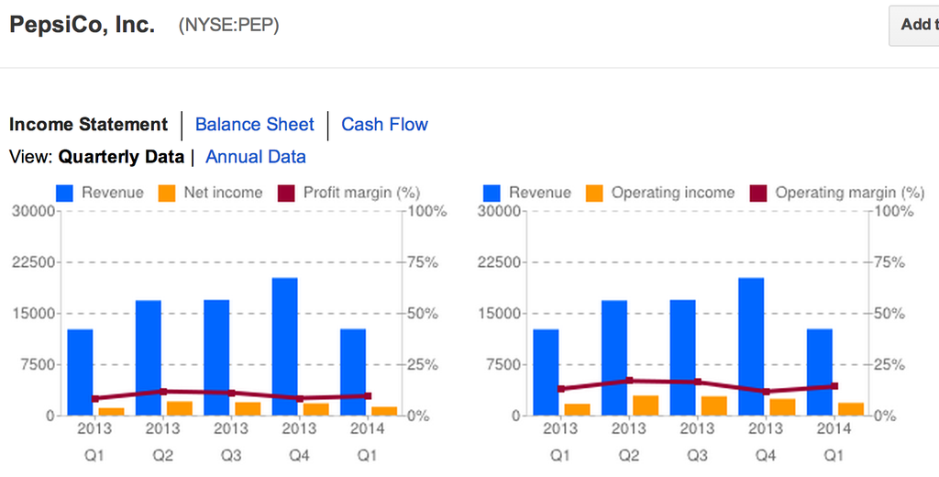
Financial Report

Slide 16
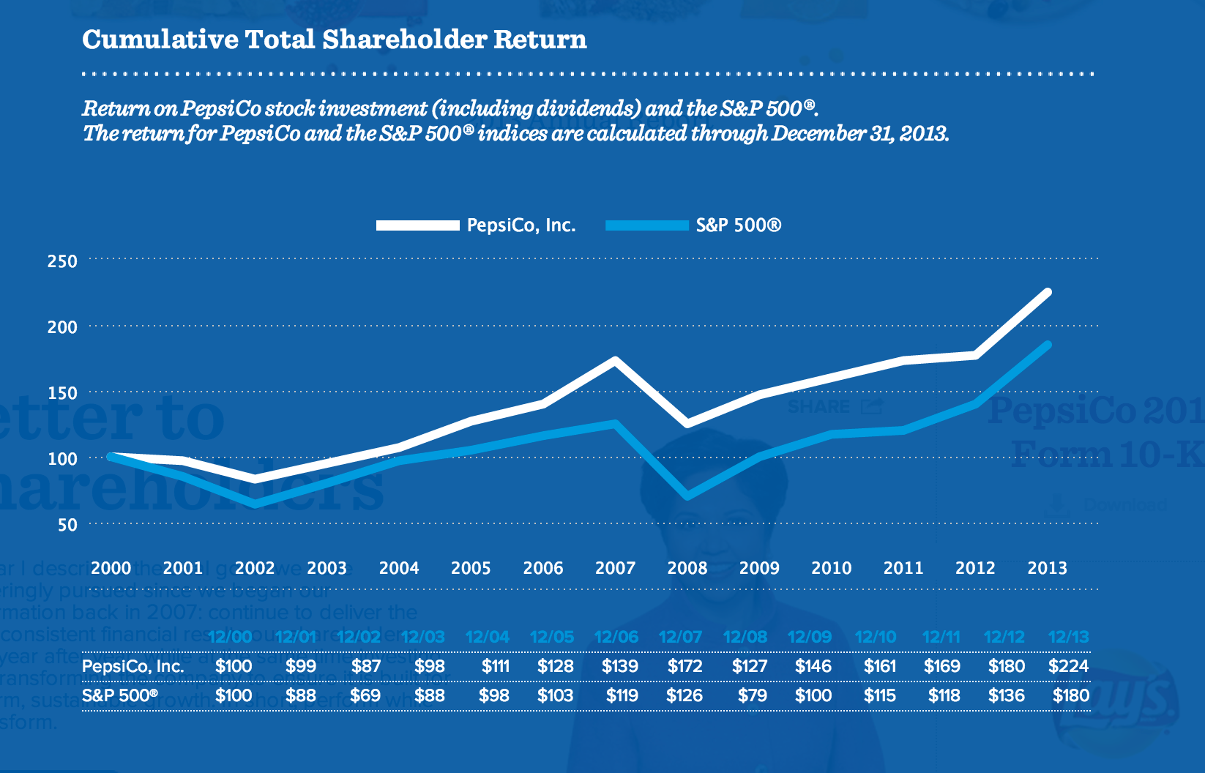
Financial Report

Slide 17
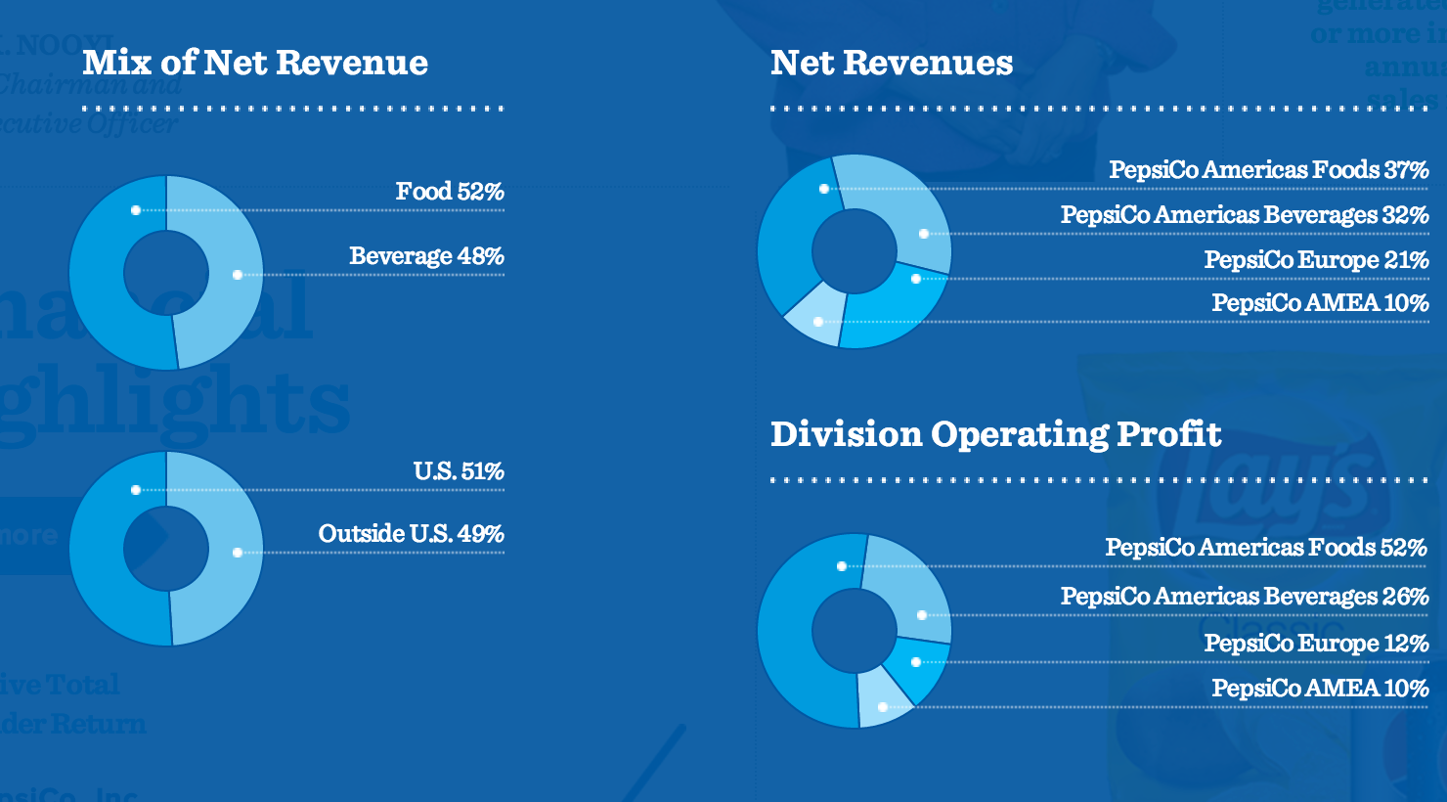
Financial Report

Slide 18
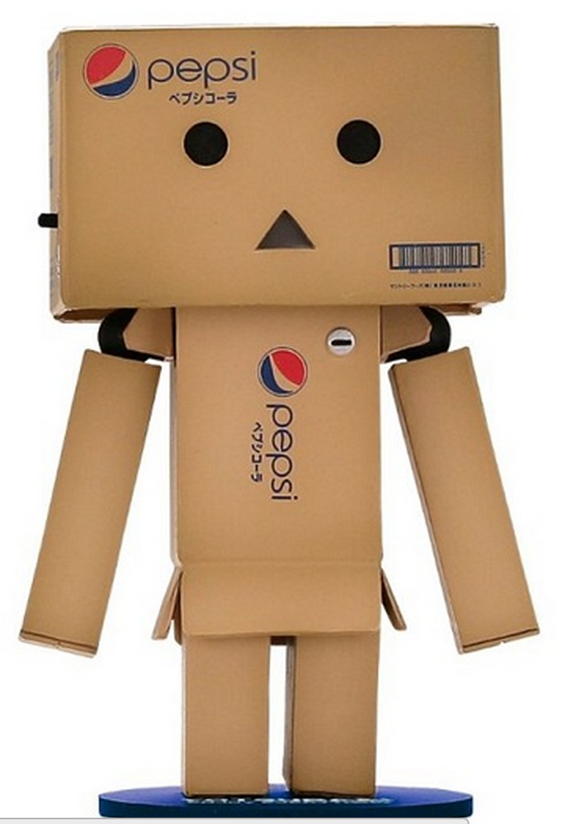
Thank You!!!

